Slide 1

Predicting customer buying beHAVIOUR
02/02/2024

Slide 2
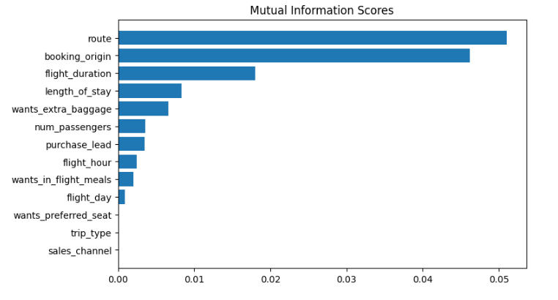
predictive model to understand factors that influence buying behaviour
We have trained the data set with Random forest classifier model and received
ACCURACY: 85.09
AUC score: 0.558

